Slide 1
MindMend
Yassin Elsharafi & Aaron Lin

Slide 2
Target Population:
Individuals suffering from mental illnesses
People without insurance
People with lower incomes

Slide 3
Issue:
Affordable care for people with mental illnesses
This will include things such as medication, multiple different therapy types, peer support, and online immediate support. to find what works best for them
Incredibly significant because one in every 5 adults in the United States have experienced some form of mental illness, while one in every 20 suffer from severe issues.

Slide 4
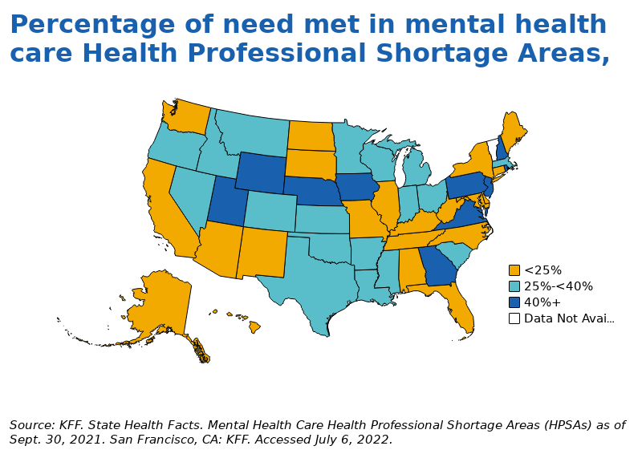
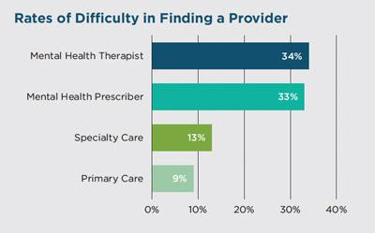
Difficulty in finding help

Slide 5
User Research Method
Public Health Reports and Research Studies: Research studies on mental health service usage can provide insights into affordability challenges and geographic disparities.
Online Forums: Analyzing common complaints from websites such as Twitter and Instagram can help identify major points we should tackle
Studying Similar Websites: Studying websites such as BetterHelp or Talkspace can help us understand what works well and what doesn’t

Slide 6
Design solution
Web Based Application
Multiple different tabs and ways to find exactly what you’re looking for
Results are dependant on the area you are in
Can use specific filters to find what would be best for the user, such as income, type of issue, etc.

Slide 7
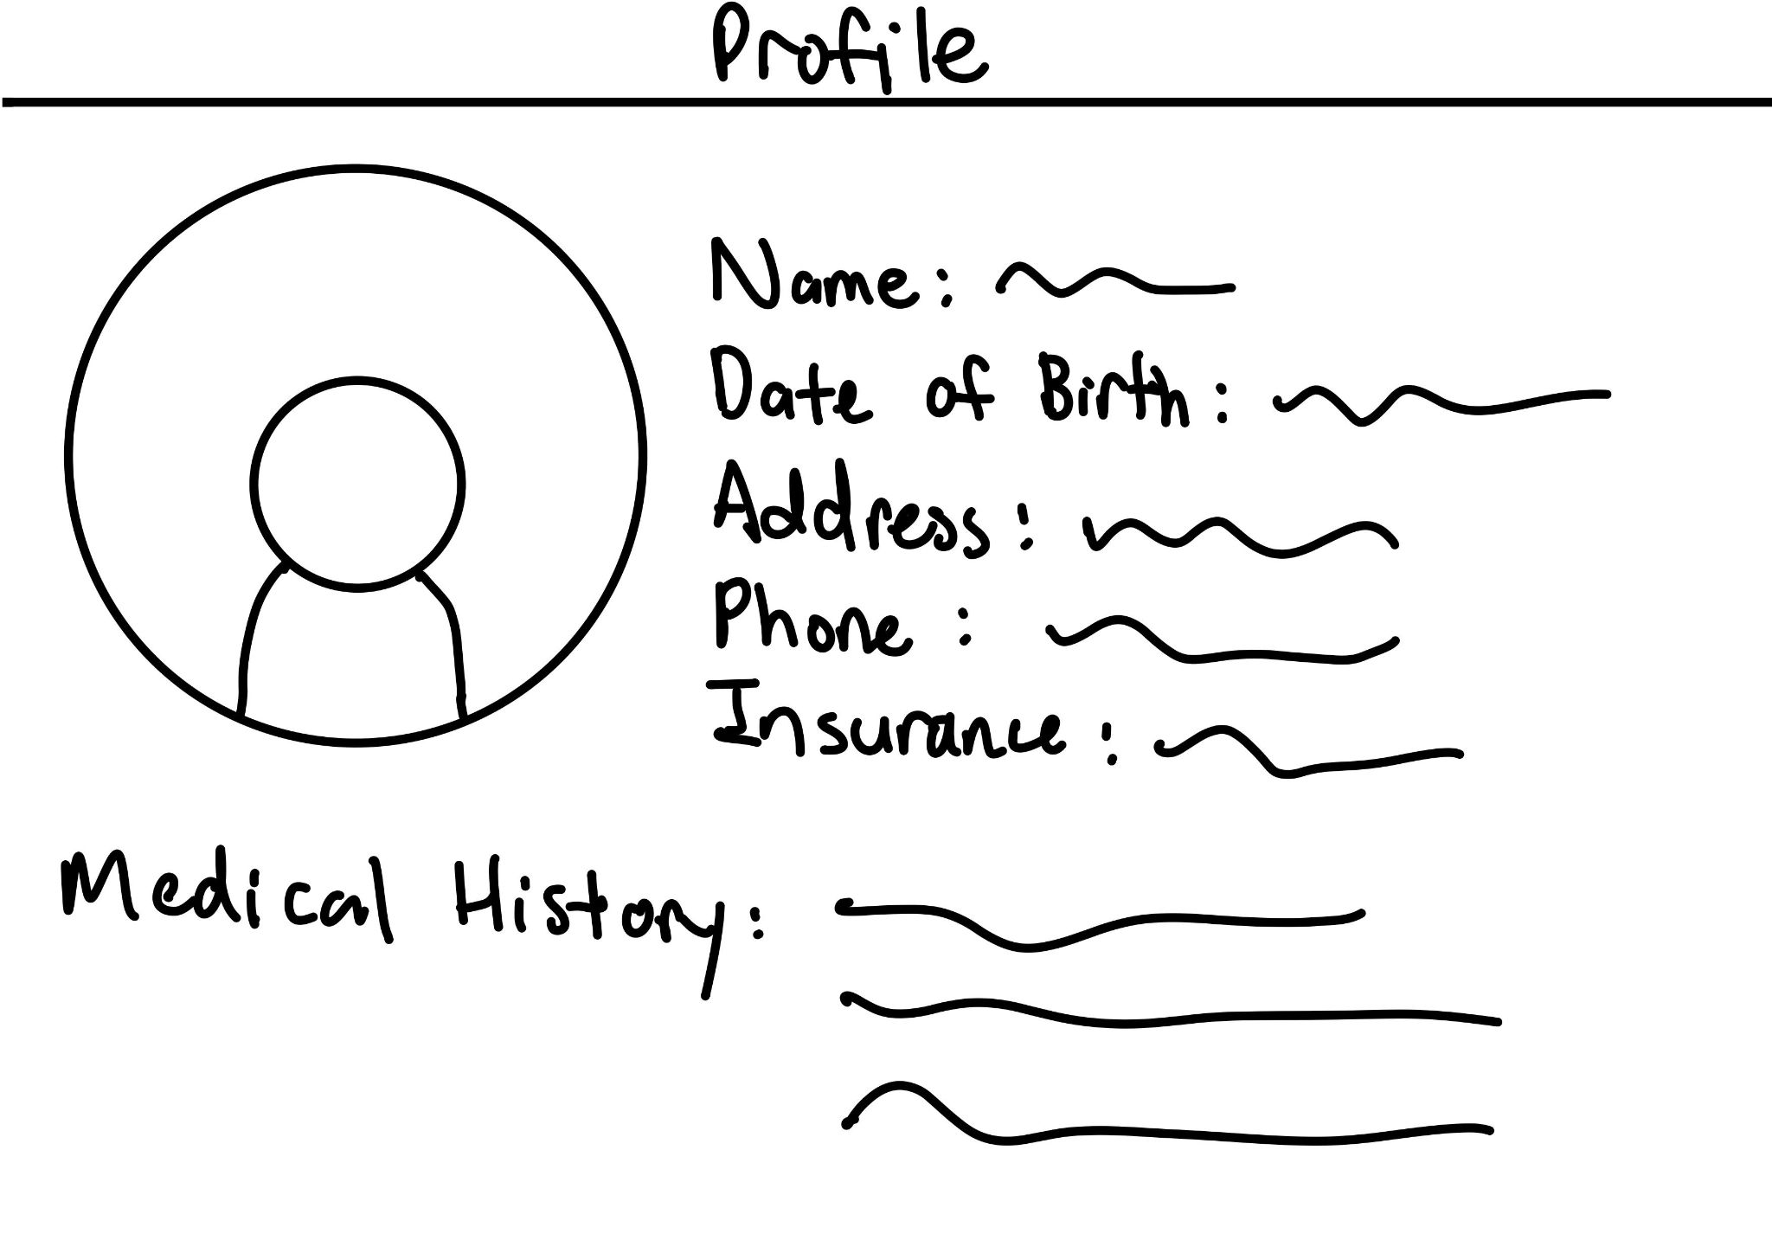
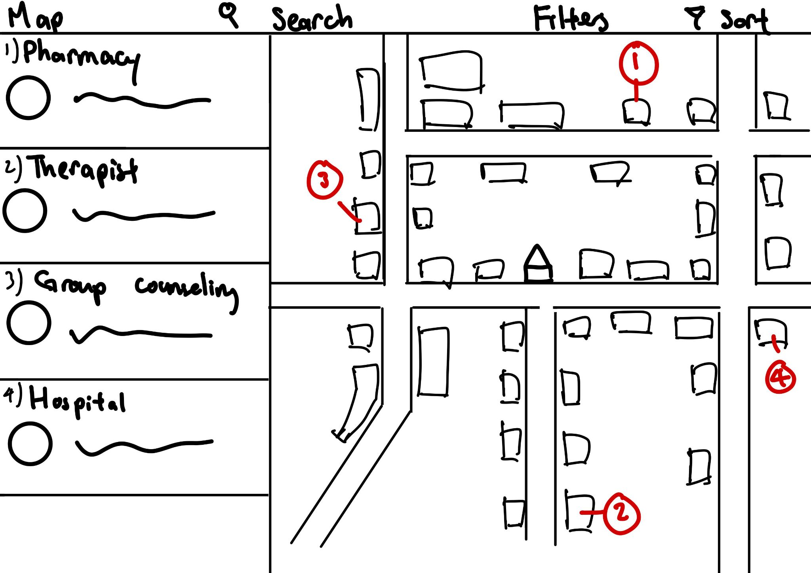
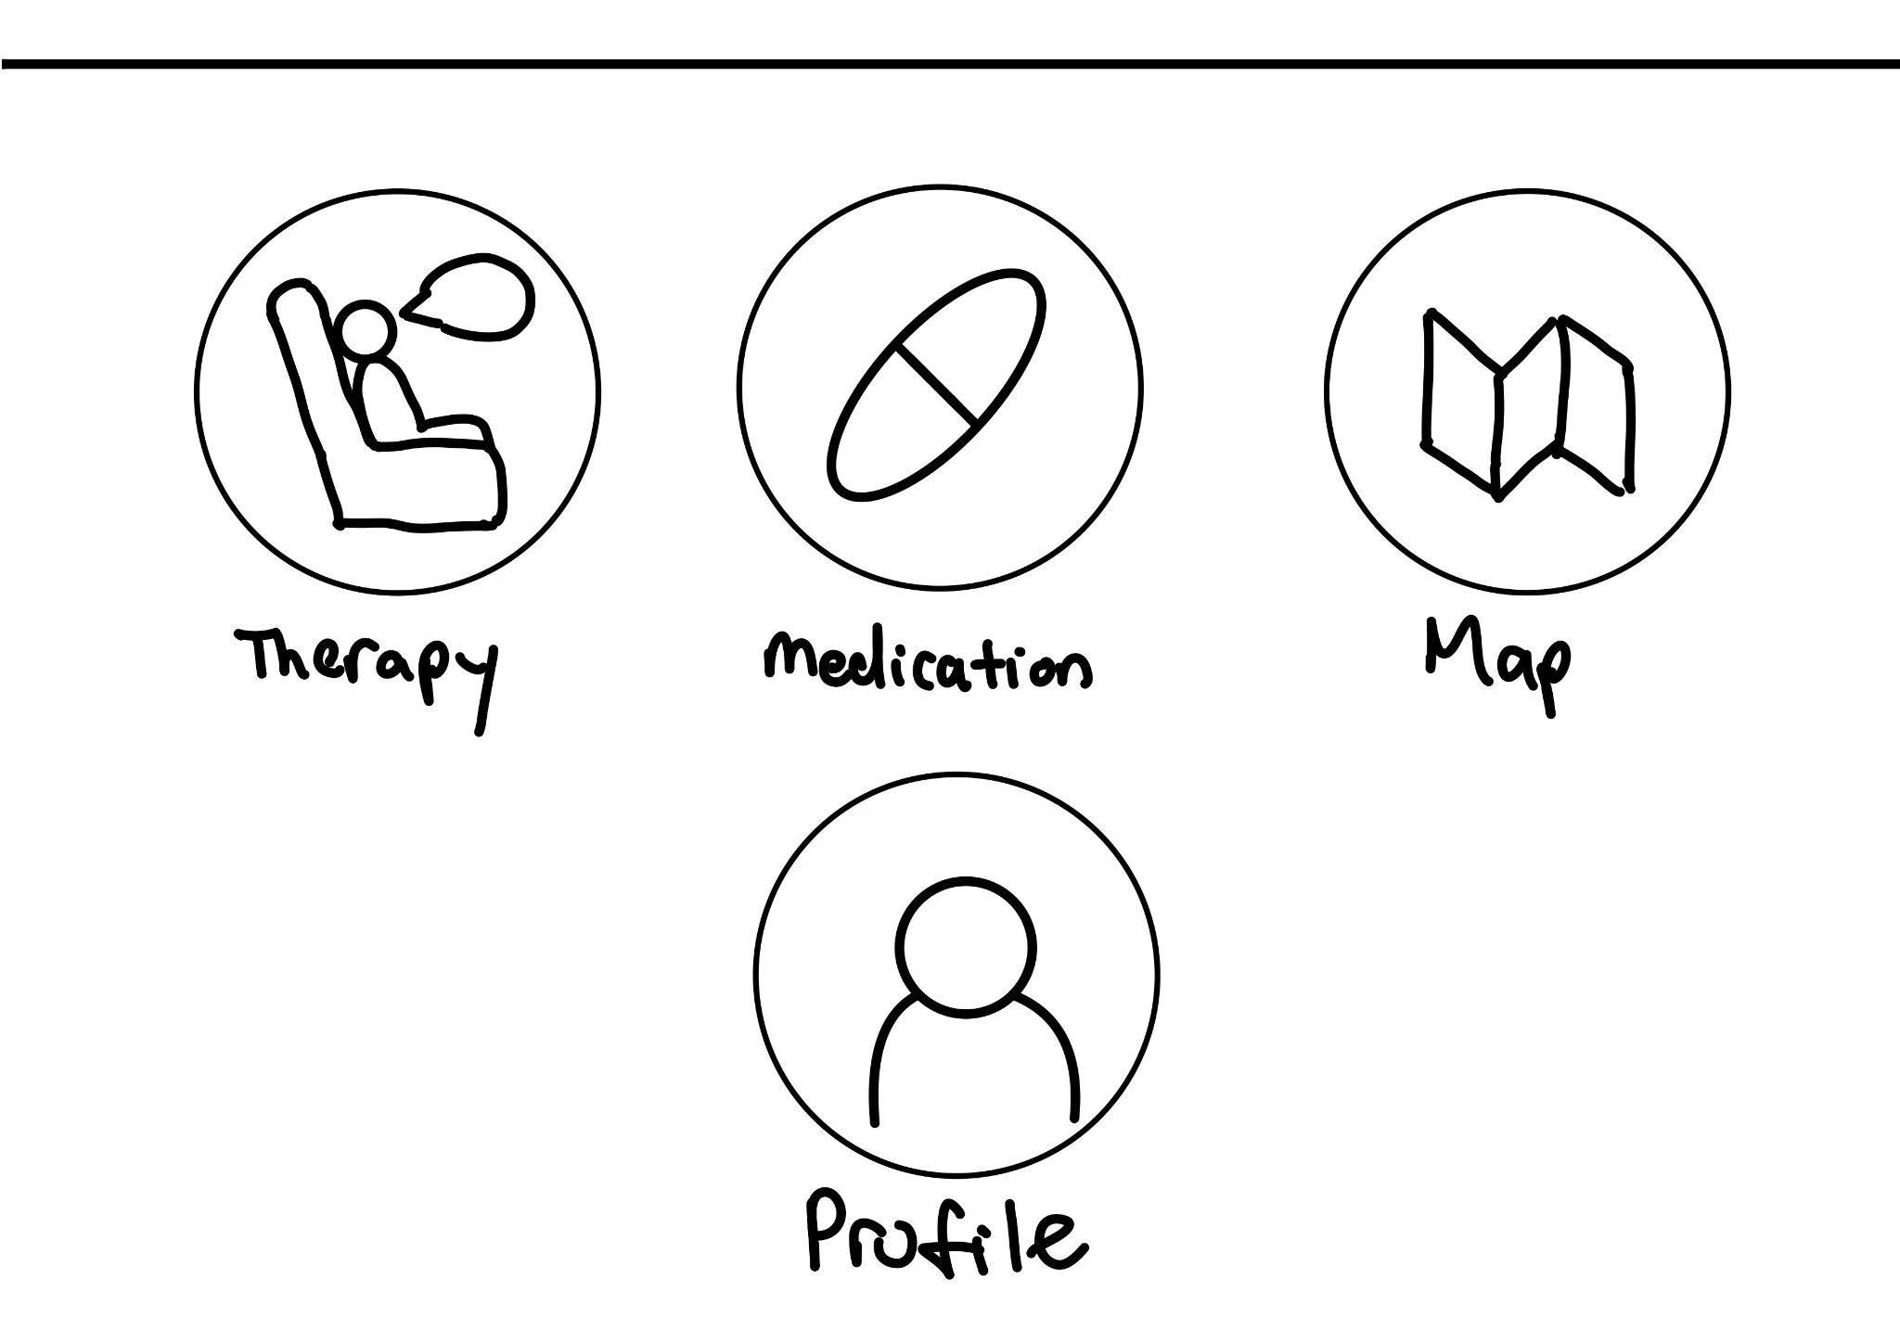
Information and medical profile
Map showing nearby locations for help w/ details and search options
Multiple options for help
Early sketches and concepts of features

Slide 8
Design Challenges
User Accessibility & Privacy – Ensuring that the app is easy to navigate and all user data is secure
Accurate & Up-to-Date Information – Ensuring all information is up to date, as any incorrect information would be incredibly detrimental to users
Engagement & Emotional Design – Since many of our users would consider this a heavy topic, we need our application to be very non-intimidating and welcoming

Slide 9
Application of 7 Principles
Discoverability – The app will have clear navigation with labeled tabs for therapy, insurance, medication, and other resources.
Feedback – Users will receive immediate visual feedback such as confirmation messages when submitting forms or selecting filters.
Conceptual Model – The app will follow a familiar structure, similar to other search-based platforms, Affordances – Buttons, search bars, and interactive elements will be designed to indicate their intended actions clearly.

Slide 10
Application of 7 Principles
Signifiers – Icons, tooltips, and highlighted sections will guide users to important features like applying filters or finding emergency contacts.
Mapping – The layout will align naturally with user expectations, such as placing the search bar at the top and filters on the side.
Constraints – Forms and search fields will have predefined options where applicable to prevent user errors (e.g., dropdown menus for selecting insurance providers).

Slide 11
Social Implications
Increased Access to Mental Healthcare – The app helps bridge the gap for those struggling to find affordable care, particularly in underserved communities
Reducing Stigma – Providing an easy-to-use, confidential platform encourages more people to seek help without fear of judgment.
Public Health Improvement – Easier access to mental health services can lead to better mental well-being, reducing long-term societal issues like unemployment and homelessness related to untreated conditions.

Slide 12
Questions?
Thank You For Your Time!

